Slide 1
S-3 | SLO-1 | Synchronous Counters
 | SLO-2 | Asynchronous Counters

Slide 2
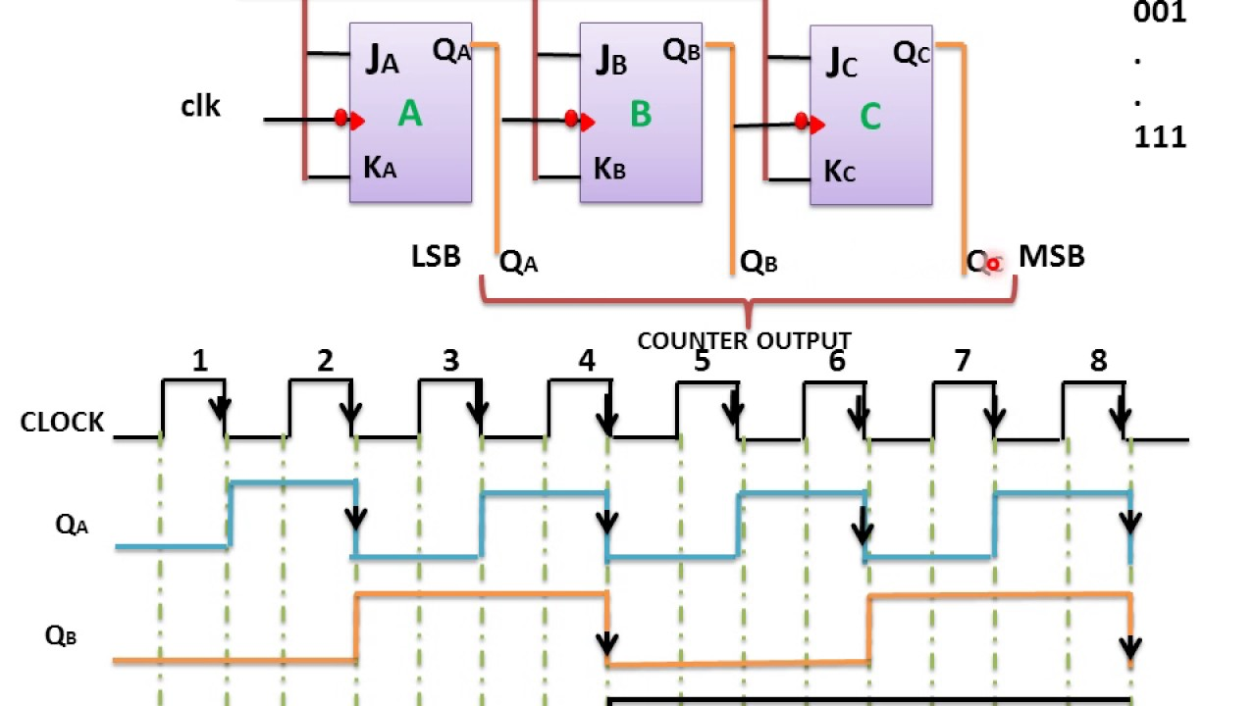
3-bit Asynchronous ripple up counter
Q2 | Q1 | Q0
0 | 0 | 0
0 | 0 | 1
0 | 1 | 0
0 | 1 | 1
1 | 0 | 0
1 | 0 | 1
1 | 1 | 0
1 | 1 | 1

Slide 3
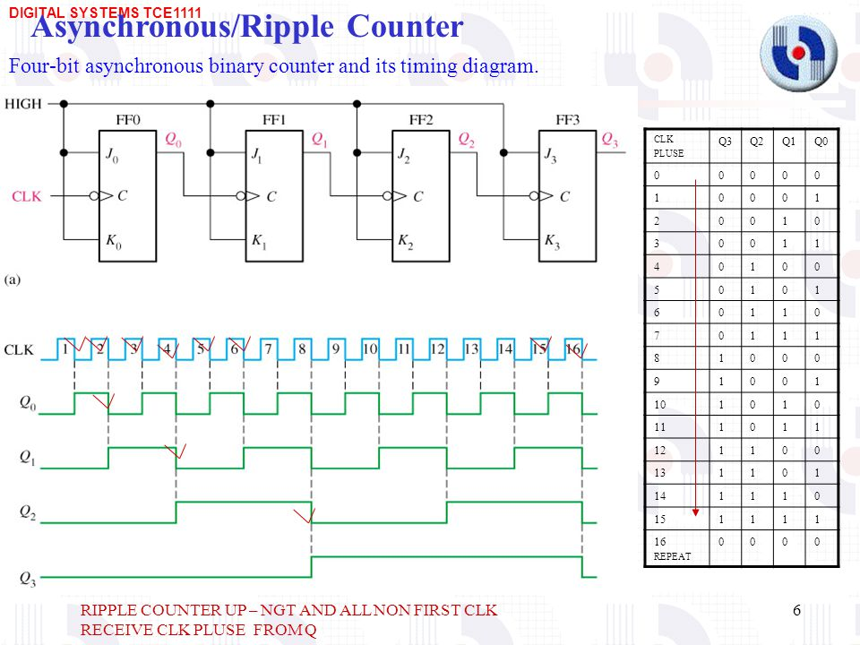
4-bit Asynchronous ripple up counter
Q3 | Q2 | Q1 | Q0
0 | 0 | 0 | 0
0 | 0 | 0 | 1
0 | 0 | 1 | 0
0 | 0 | 1 | 1
0 | 1 | 0 | 0
0 | 1 | 0 | 1
0 | 1 | 1 | 0
0 | 1 | 1 | 1
1 | 0 | 0 | 0
1 | 0 | 0 | 1
1 | 0 | 1 | 0
1 | 0 | 1 | 1
1 | 1 | 0 | 0
1 | 1 | 0 | 1
1 | 1 | 1 | 0
1 | 1 | 1 | 1

Slide 4
Synchronous counters
Synchronous (parallel) counters: The flip-flops are clocked at the same time by a common clock pulse.
Synchronous counters have been designed using the sequential logic design process.

Slide 5
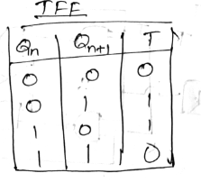
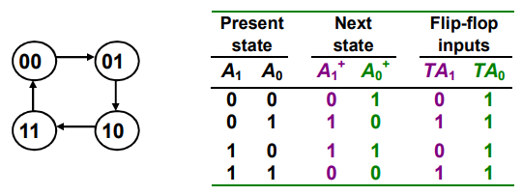

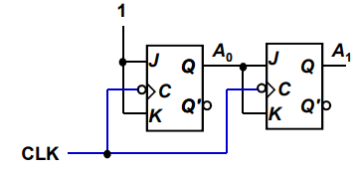
Example: Design a 2-bit synchronous binary counter using T flip-flops

Slide 6
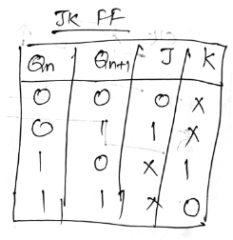
Example: Design a 4-bit synchronous binary UP counter using JK flip-flops
STEP 1 – Excitation Table
Present state |  |  |  | Next state |  |  |  | Flip Flop inputs
QD | QC | QB | QA | QD | QC | QB | QA | JQD | KQD | JQC | KQC | JQB | KQB | JQA | KQA
0 | 0 | 0 | 0 | 0 | 0 | 0 | 1 | 0 | X | 0 | X | 0 | X | 1 | X
0 | 0 | 0 | 1 | 0 | 0 | 1 | 0 | 0 | X | 0 | X | 1 | X | X | 1
0 | 0 | 1 | 0 | 0 | 0 | 1 | 1 | 0 | X | 0 | X | X | 0 | 1 | X
0 | 0 | 1 | 1 | 0 | 1 | 0 | 0 | 0 | X | 1 | X | X | 1 | X | 1
0 | 1 | 0 | 0 | 0 | 1 | 0 | 1 | 0 | X | X | 0 | 0 | X | 1 | X
0 | 1 | 0 | 1 | 0 | 1 | 1 | 0 | 0 | X | X | 0 | 1 | X | X | 1
0 | 1 | 1 | 0 | 0 | 1 | 1 | 1 | 0 | X | X | 0 | X | 0 | 1 | X
0 | 1 | 1 | 1 | 1 | 0 | 0 | 0 | 1 | X | X | 1 | X | 1 | X | 1
1 | 0 | 0 | 0 | 1 | 0 | 0 | 1 | X | 0 | 0 | X | 0 | X | 1 | X
1 | 0 | 0 | 1 | 1 | 0 | 1 | 0 | X | 0 | 0 | X | 1 | X | X | 1
1 | 0 | 1 | 0 | 1 | 0 | 1 | 1 | X | 0 | 0 | X | X | 0 | 1 | X
1 | 0 | 1 | 1 | 1 | 1 | 0 | 0 | X | 0 | 1 | X | X | 1 | X | 1
1 | 1 | 0 | 0 | 1 | 1 | 0 | 1 | X | 0 | X | 0 | 0 | X | 1 | X
1 | 1 | 0 | 1 | 1 | 1 | 1 | 0 | X | 0 | X | 0 | 1 | X | X | 1
1 | 1 | 1 | 0 | 1 | 1 | 1 | 1 | X | 0 | X | 0 | X | 0 | 1 | X
1 | 1 | 1 | 1 | 0 | 0 | 0 | 0 | X | 1 | X | 1 | X | 1 | X | 1

Slide 7
STEP 2 – K map
Qb, Qa Qd, Qc | 00 | 01 | 11 | 10
00 | 0 | 0 | 0 | 0
01 | 0 | 0 | 1 | 0
11 | X | X | X | X
10 | X | X | X | X
Qb, Qa Qd, Qc | 00 | 01 | 11 | 10
00 | X | X | X | X
01 | X | X | X | X
11 | 0 | 0 | 1 | 0
10 | 0 | 0 | 0 | 0
Jd= Qa.Qb.Qc
Kd= Qa.Qb.Qc
Qb, Qa Qd, Qc | 00 | 01 | 11 | 10
00 | 0 | 0 | 1 | 0
01 | X | X | X | X
11 | X | X | X | X
10 | 0 | 0 | 1 | 0
Qb, Qa Qd, Qc | 00 | 01 | 11 | 10
00 | X | X | X | X
01 | 0 | 0 | 1 | 0
11 | 0 | 0 | 1 | 0
10 | X | X | X | X
Jc= Qa.Qb
Kc= Qa.Qb

Slide 8
Qb, Qa Qd, Qc | 00 | 01 | 11 | 10
00 | 0 | 1 | X | X
01 | 0 | 1 | X | X
11 | 0 | 1 | X | X
10 | 0 | 1 | X | X
Qb, Qa Qd, Qc | 00 | 01 | 11 | 10
00 | X | X | 1 | 0
01 | X | X | 1 | 0
11 | X | X | 1 | 0
10 | X | X | 1 | 0
Jb= Qa
Kb= Qa
Qb, Qa Qd, Qc | 00 | 01 | 11 | 10
00 | 1 | 1 | 1 | 1
01 | X | X | X | X
11 | X | X | X | X
10 | 1 | 1 | 1 | 1
Qb, Qa Qd, Qc | 00 | 01 | 11 | 10
00 | X | X | X | X
01 | 1 | 1 | 1 | 1
11 | 1 | 1 | 1 | 1
10 | X | X | X | X
Ja=1
Ka= 1

Slide 9
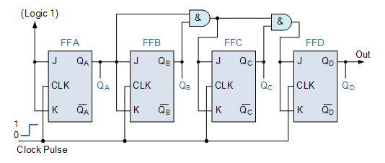
STEP 3 – Implementation
Jd= Qa.Qb.Qc
Kd= Qa.Qb.Qc
Jc= Qa.Qb
Kc= Qa.Qb
Jb= Qa
Kb= Qa
Ja=1
Ka= 1

Slide 10
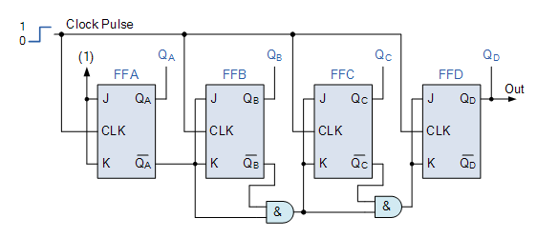
4-bit synchronous binary Down counter using JK flip-flops

Slide 11
Up/Down Synchronous Counters
Up/down synchronous counter: a bidirectional counter that is capable of counting either up or down.
An input (control) line Up/Down (or simply Up) specifies the direction of counting.
Up/Down = 1 Count upward Up/Down = 0 then Count downward

Slide 12
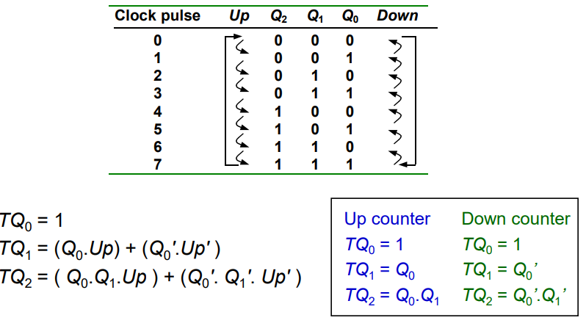
Eg: 3-bit Up/Down Synchronous Counters

Slide 13
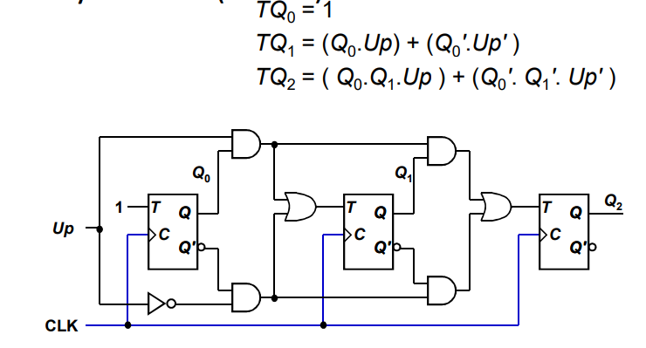
Eg: 3-bit Up/Down Synchronous Counters

Slide 14
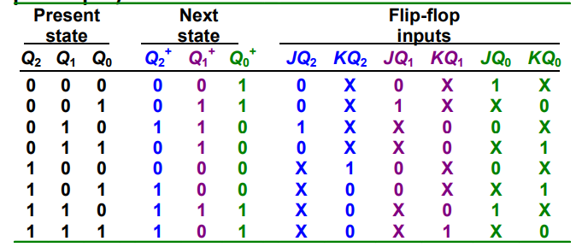
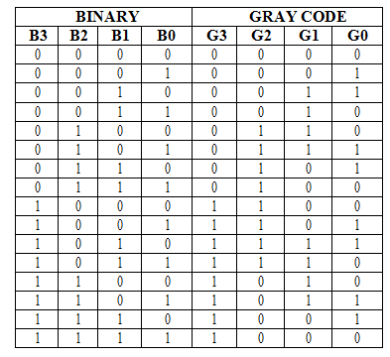
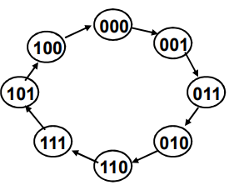
Eg: 3 bit Gray code counter using JK flipflop

Slide 15
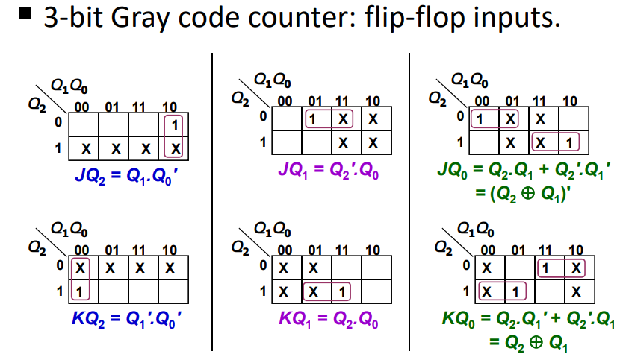
Eg: 3 bit Gray code counter using JK flipflop

Slide 16
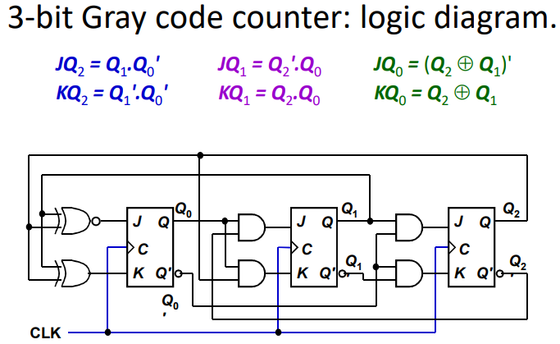
Eg: 3 bit Gray code counter using JK flipflop

